Slide 1
Complete Matching Bipartite Graphs
Diego Mackay
Karan Danoa
Sunny Pak

Slide 2
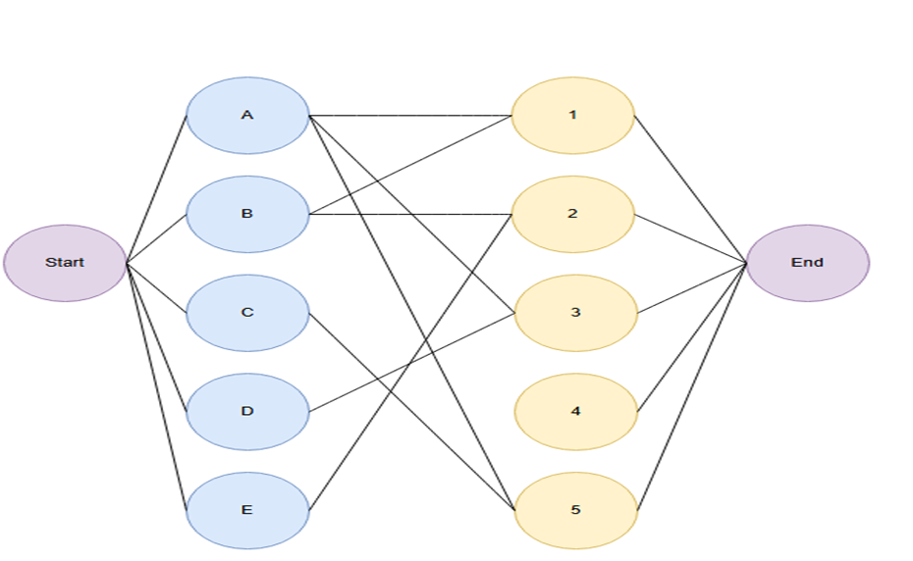

Bipartite graph
Bipartite graph is a type of graph where the set of vertices can be divided into two disjoint sets.
In a bipartite graph, edges always point from vertices in group X to vertices in group Y, though this direction is not always visually represented.
The goal of bipartite matching is to find the maximum number of edges that can be selected such that no two edges share a common vertex, pairing vertices from the two groups in a way that maximizes the number of matchings.
This means that every edge in the graph connects a vertex in group X to a vertex in group Y. Each edge in the graph has a capacity of 1, meaning that each edge can only support one connection at a time
Figure 1. Bipartite graph
Kingsford, C. (n.d.). Matching. Retrieved from https://www.cs.cmu.edu/~ckingsf/bioinfo-lectures/matching.pdf (n.d.). Kuhn's algorithm for maximum bipartite matching. CP-Algorithms. Retrieved from https://cp-algorithms.com/graph/kuhn_maximum_bipartite_matching.html MIT OpenCourseWare. (2007, Spring). Lecture: Matching [Video]. YouTube. https://www.youtube.com/watch?v=HZLKDC9OSaQ Goemans, M. (2007, Spring). Matching notes. MIT Mathematics. Retrieved from https://math.mit.edu/~goemans/18433S07/matching-notes.pdf

Slide 3
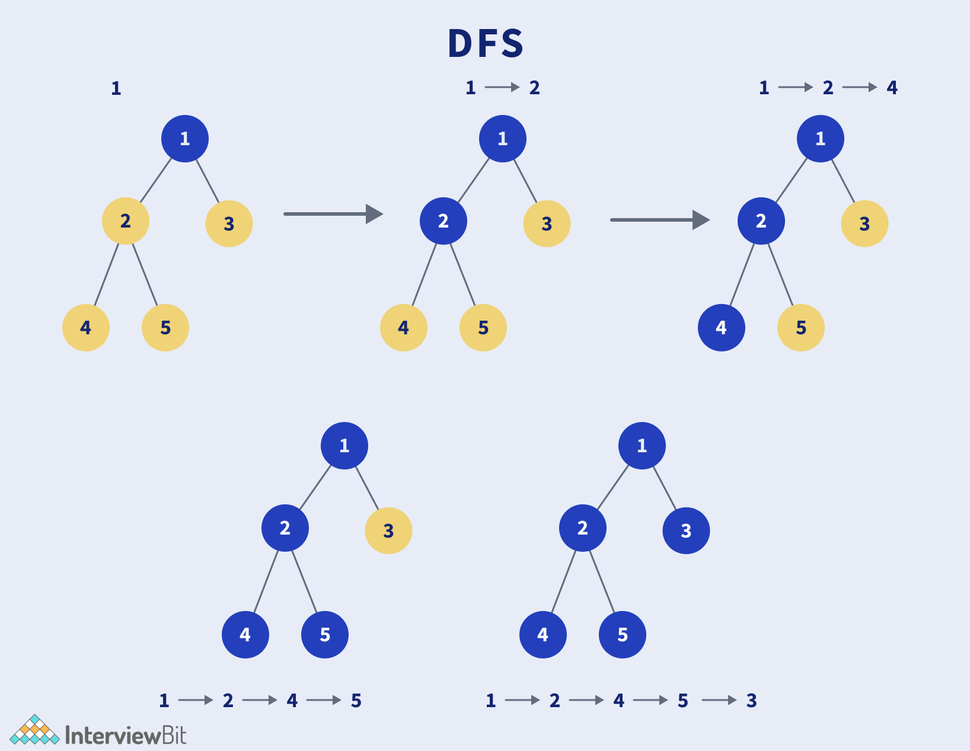
Matching
A matching in a graph refers to a set of edges where no two edges share a common vertex. In the context of bipartite graphs, a matching involves pairing vertices from group X with vertices from group Y, ensuring that each vertex from both groups is matched with at most one vertex from the other group
In this case, the capacity of 1 for each edge means that no vertex can be part of more than one matching simultaneously
Depth-First Search(DFS) is used to solve this problem more efficiently. DFS recursive algorithm traverses the graph, starting at the root of the grpah and explores vertices continuously.
DFS has been used because it does the deep searching, and deep searching all the possibilities of the vertices allow algorithm to get maximum number of matchings.
Kingsford, C. (n.d.). Matching. Retrieved from https://www.cs.cmu.edu/~ckingsf/bioinfo-lectures/matching.pdf (n.d.). Kuhn's algorithm for maximum bipartite matching. CP-Algorithms. Retrieved from https://cp-algorithms.com/graph/kuhn_maximum_bipartite_matching.html MIT OpenCourseWare. (2007, Spring). Lecture: Matching [Video]. YouTube. https://www.youtube.com/watch?v=HZLKDC9OSaQ Goemans, M. (2007, Spring). Matching notes. MIT Mathematics. Retrieved from https://math.mit.edu/~goemans/18433S07/matching-notes.pdf
Depth First Search - Traversal Of The Graph – InterviewBit
https://www.interviewbit.com/blog/depth-first-search/
Figure 2. DFS Algorithm

Slide 4
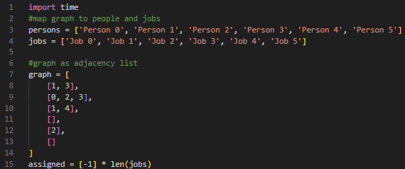
Python
Bipartite Maximum Matching

Slide 5
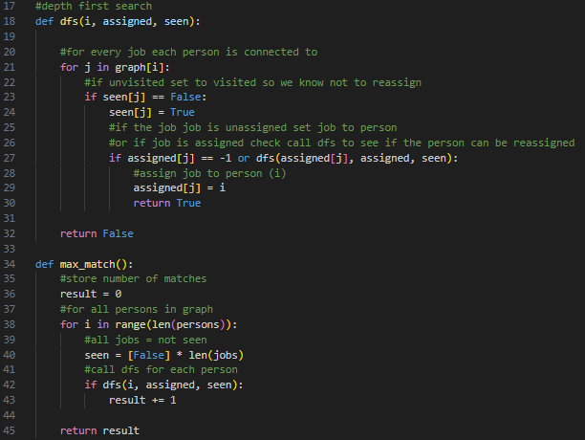
Python
https://www.geeksforgeeks.org/maximum-bipartite-matching/

Slide 6
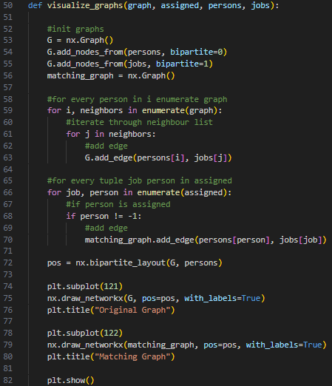
Python
https://networkx.org/documentation/stable/reference/algorithms/bipartite.html#module-networkx.algorithms.bipartite
https://memgraph.github.io/networkx-guide/visualization/basics/

Slide 7
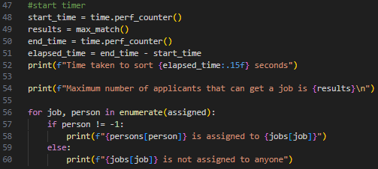
Python
Time Max Match

Slide 8
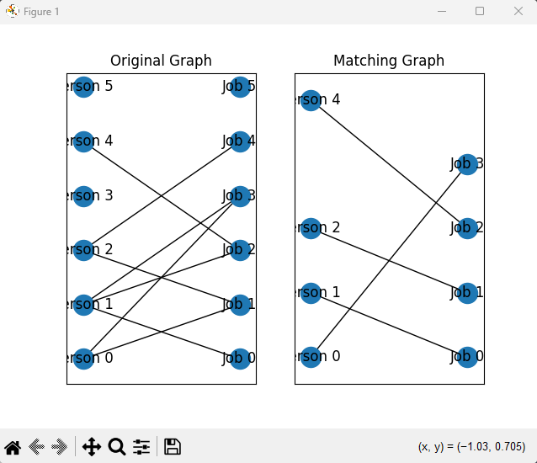
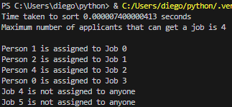
Python

Slide 9
Python
Time Complexity:
O(VE)
Iterates over each vertex
Performs DFS on every edge
Space Complexity:
O(V+E)
Graph Adjacency list
Assigned/Seen list
https://www.geeksforgeeks.org/maximum-bipartite-matching/

Slide 10

Java
Bipartite graphs are graphs whose vertices can be divided into two disjoint and independent sets such that no two graph vertices within the same set are adjacent.
Maximum matching is about finding the maximum set of edges that connect pairs of nodes from two sets without shared endpoints.
Some applications include job matching and network flow

Slide 11
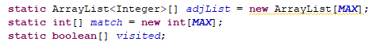
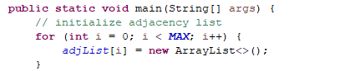
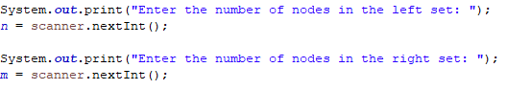
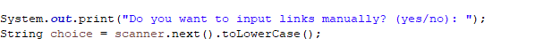
Program Structure and Initialization
Key Data Structures Used:
adjList: Stores connections between nodes.
match: Tracks which node is matched to which.
visited: Keeps track of visited nodes during searches.
Initialization and Input Handling:
Input number of nodes for both left (n) and right (m) sets.
Choose between manually entering links or generating a random graph.

Slide 12
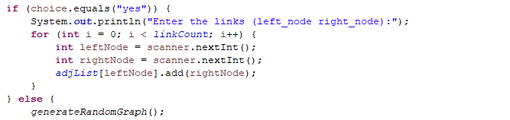
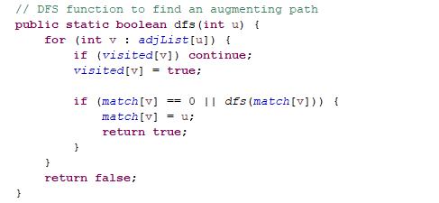
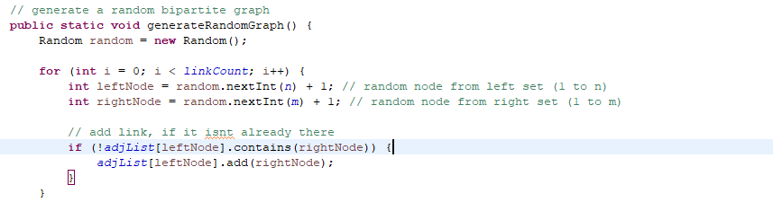
Generating and Searching the Graph
Graph Generation Options:
Manual entry: Directly enter pairs of nodes.
Random generation: Randomly connects nodes ensuring no duplicates."
DFS (Depth-First Search) Method:
Explores potential matches trying to find augmenting paths.
Recursively attempts to match nodes ensuring maximum pairing.

Slide 13
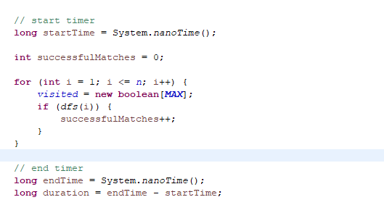
Processing Matches and Performance
Matching Process:
Iterates over nodes in the left set, using DFS to find and augment matches."
Counts and reports the number of successful matches.
Performance Measurement:
Uses System.nanoTime() to measure execution time.
Outputs total time taken, providing insight into the algorithm’s efficiency.

Slide 14
Summary and Potential Applications
This program efficiently solves the maximum matching problem in bipartite graphs using DFS.
Applications extend to optimizing systems in real-world scenarios such as labor markets and network designs.
For further details and a deeper dive into the code, feel free to reach out and ask questions.

Slide 15
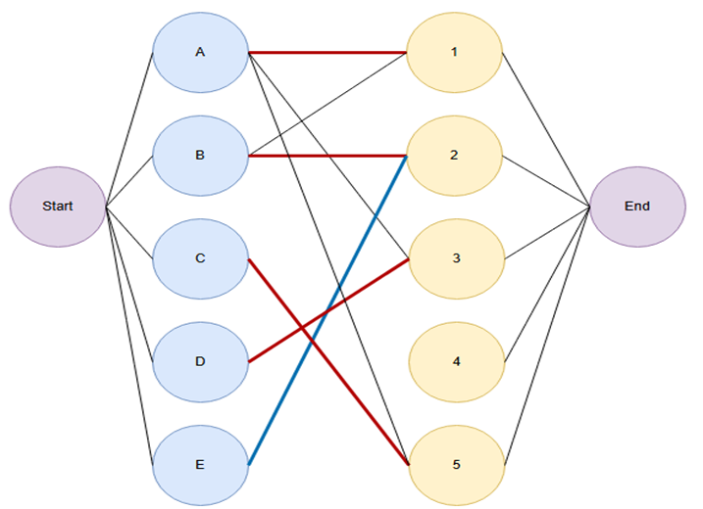
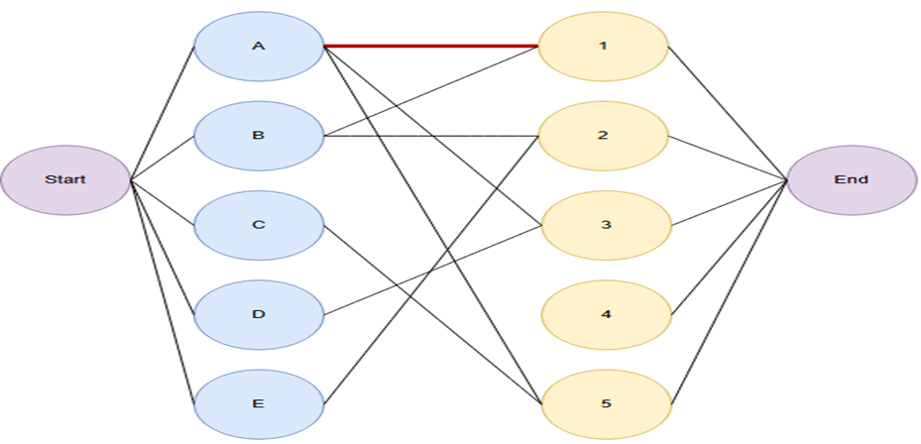
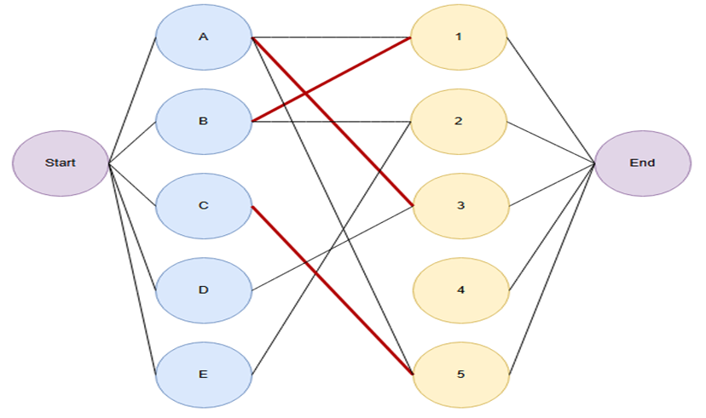
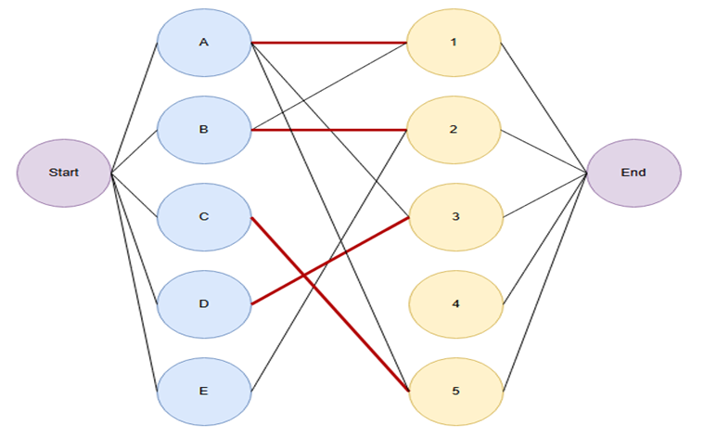
C++
The direction of the edges begins from the left, and is matched to the right.
Vertex A, is matched with vertex 1.
.
Next, Vertex B tries to match with Vertex 1, but it has already been matched by Vertex A. Vertex A therefore must search for a new matching vertex. Vertex A matches with Vertex 3.
Afterwards, vertex C matches with vertex 5.
Vertex D wants to match with vertex 3, but it is occupied. Vertex A however, has vertex 3, so A searches for a new direction and tries to match with vertex 1. Vertex 1, is also matched with vertex B, so B searches for a new direction and matches with vertex 2
Last vertex E, wants to match with vertex 2. However, vertex E cannot match with 2, because if vertex E matches with vertex 2, B and A and D must all search for new directions.
Therefore matching with vertex 2 is impossible for vertex E. The maximum number of matches remains as 4.

Slide 16
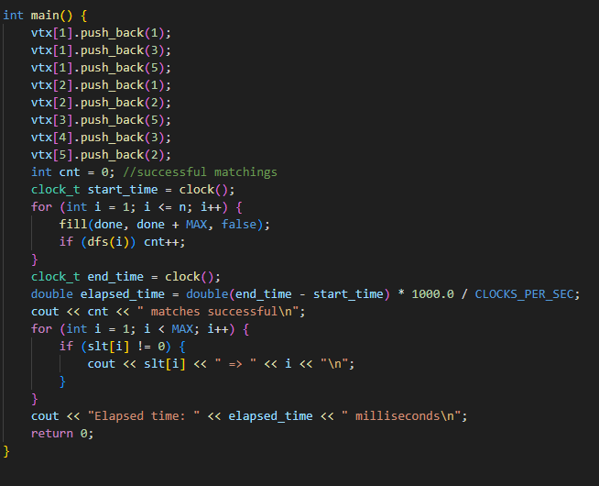
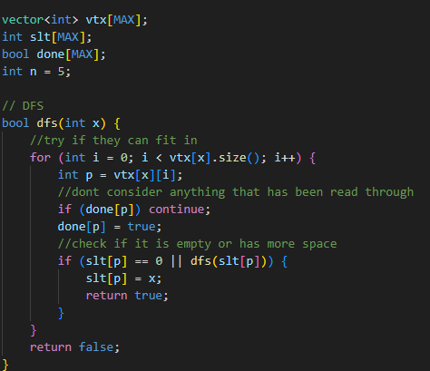
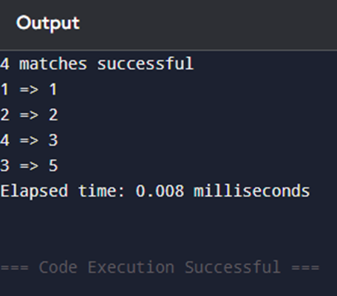
C++
The output executed below with C++ represents the theory of bipartite algorithms that is correctly applied to the implementation.
Vertex A, in this case 1 is matched with 1, Vertex B(2) with 2. Vertex D(4) is matched with 3, and finally, Vertex C(3) with 5.
E could not find a successful match, therefore the bipartite graph remains with maximum matches of four.

Slide 17
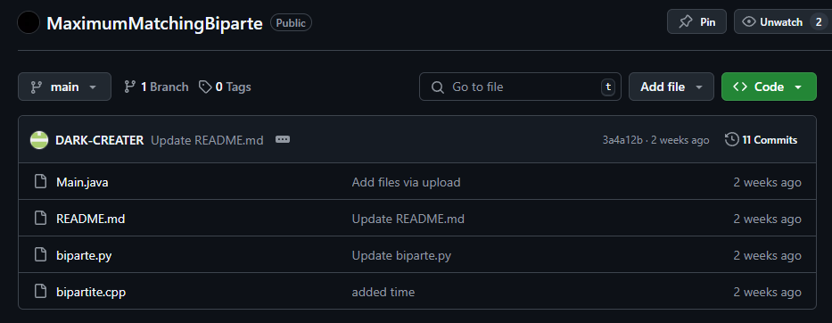
Github

Slide 18
References and tools
References C++
Kingsford, C. (n.d.). Matching. Retrieved from https://www.cs.cmu.edu/~ckingsf/bioinfo-lectures/matching.pdf (n.d.). Kuhn's algorithm for maximum bipartite matching. CP-Algorithms. Retrieved from https://cp-algorithms.com/graph/kuhn_maximum_bipartite_matching.html MIT OpenCourseWare. (2007, Spring). Lecture: Matching [Video]. YouTube. https://www.youtube.com/watch?v=HZLKDC9OSaQ Goemans, M. (2007, Spring). Matching notes. MIT Mathematics. Retrieved from https://math.mit.edu/~goemans/18433S07/matching-notes.pdf
Bunescu, R. (n.d.). Lecture 21: Graph algorithms. University of North Carolina at Charlotte. Retrieved from https://webpages.charlotte.edu/rbunescu/courses/ou/cs4040/lecture21.pdf
Draw io for drawing bipartite graphs
Visual studio code for debugging/implementation

